Slide 1
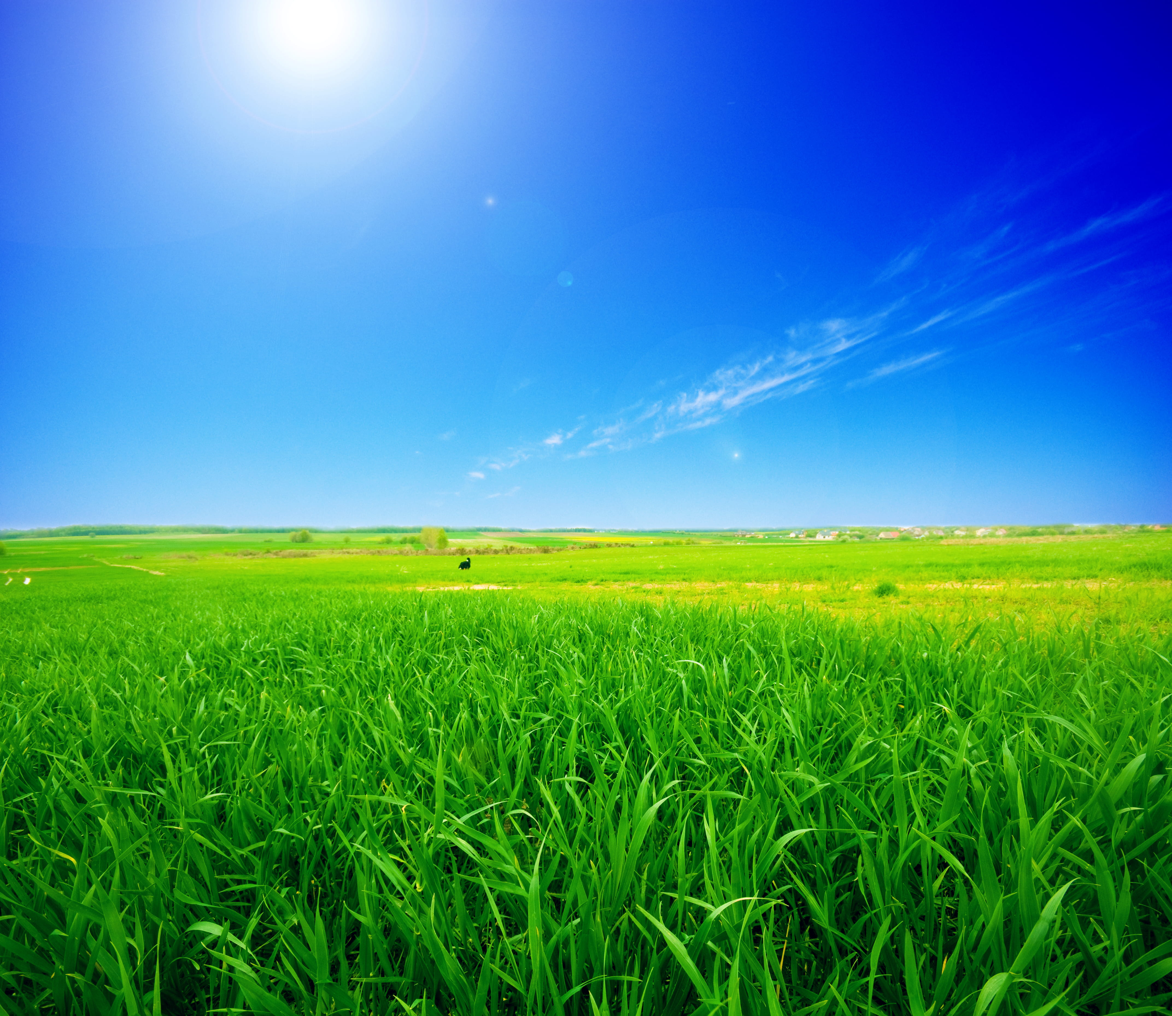
AgriTrack Smart Farming Data Management System
Empowering Farmers with Data-Driven Insights

Slide 2
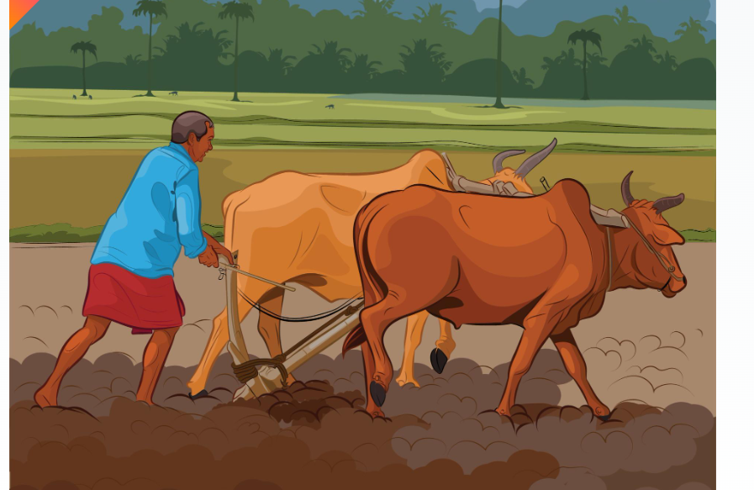
Objective
To develop a centralized database management system that stores and analyzes farmers’ land, crop, fertilizer, income, expenditure, fertilizer usage and market demand data
In order to help the government provide accurate guidance to farmers on crop selection, reduce supply-demand imbalances, prevent shortage and wastage of fertilizers and ensure fair pricing and sustainable agriculture.

Slide 3
Problem Statement
Unbalanced Crop Production: Farmers often sow the same crop without knowing market demand leads to oversupply or under supply.
Lack of Reliable Land Records: Many farms don’t have proper revenue record leads to land disputes
Inefficient Fertilizer Usage
Lack of a centralized system to track crops, land, fertilizer, market prices, and weather.

Slide 4
Proposed System (AgriTrack)
Centralized DB for:
Land Details
Crop Details
Fertilizer Usage
Income & Expenditure
Market Demand & Prices
Weather Details
Farmer Details

Slide 5
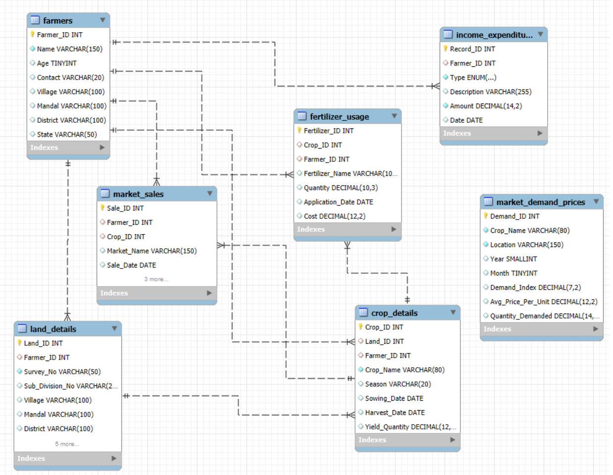
ER DIAGRAM

Slide 6
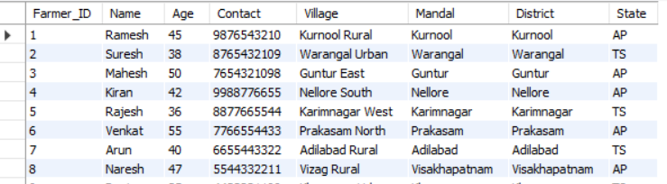
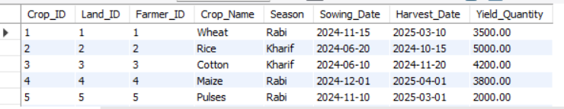
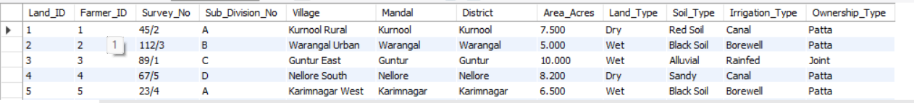
Tables Overview:
Table 1: Farmer
Table 3:Crop Details
Table 2 : Land Details

Slide 7
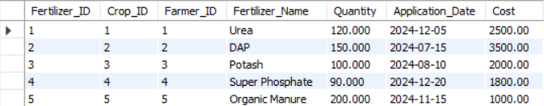
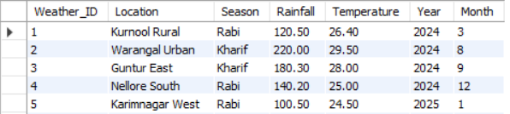
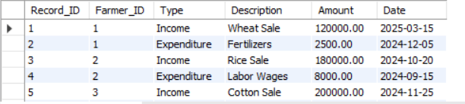
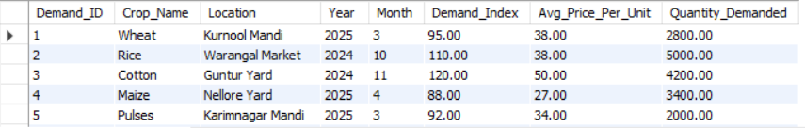
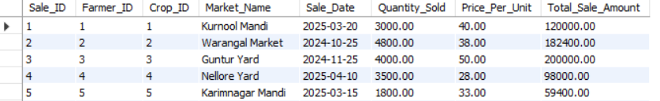
Table 4: Fertilizer Usage
Table 7 : Weather Data
Table 5: Income Expenditure
Table 8 : Market Demand Prices
Table 6 : Market Sales

Slide 8
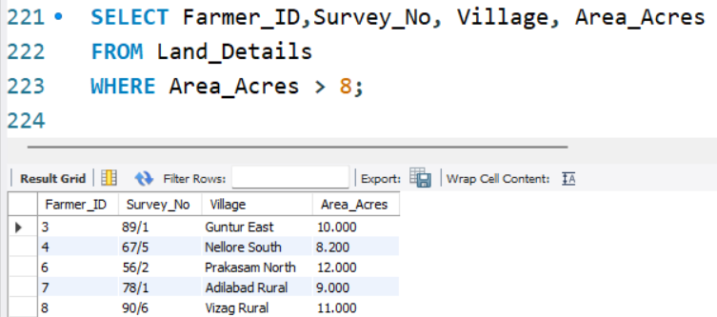
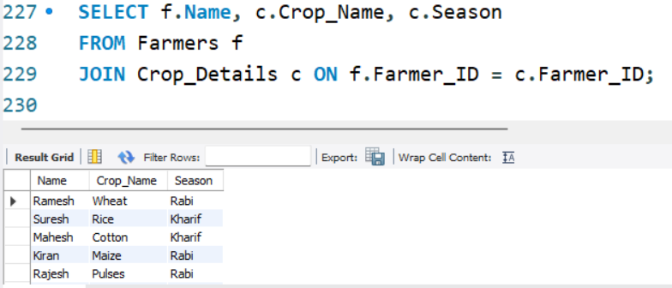
Land Records & Crops Insights
Q1. Show all land parcels larger than 8 acres.
Q2. Get farmer names along with crops they grew

Slide 9
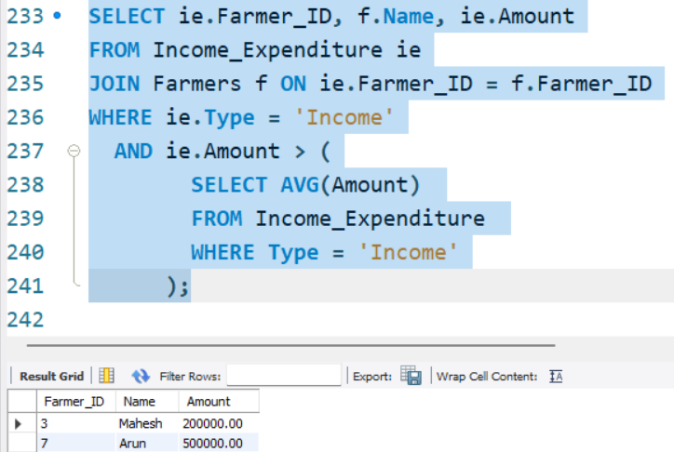
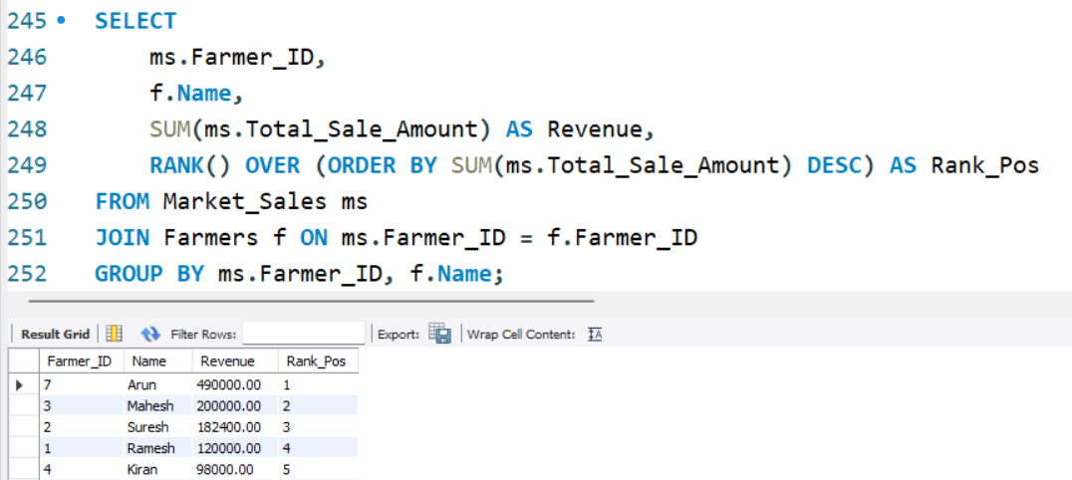
Income Expenditure & Profit Analysis
Q3. Find farmers who earned more than the average income.
Q4. Rank farmers based on their total sales amount.

Slide 10
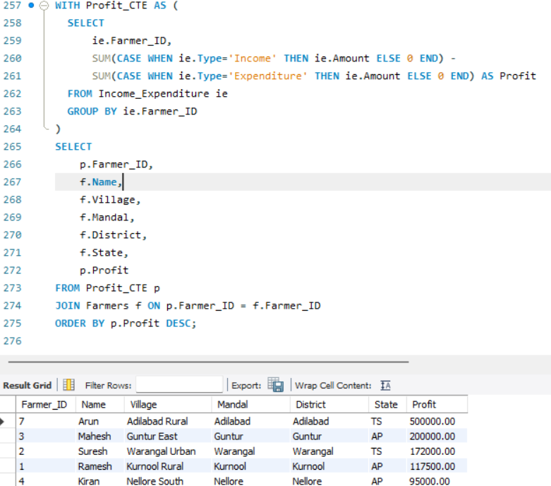
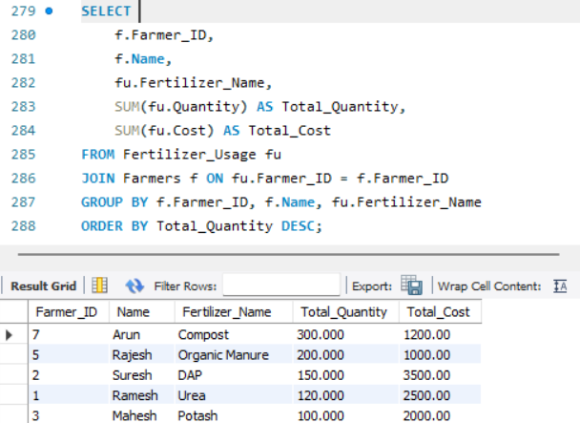
Q5.calculate profit (Income – Expenditure) for each farmer.
Fertilizer Usage Insights
Q6 Track total fertilizer usage per farmer

Slide 11
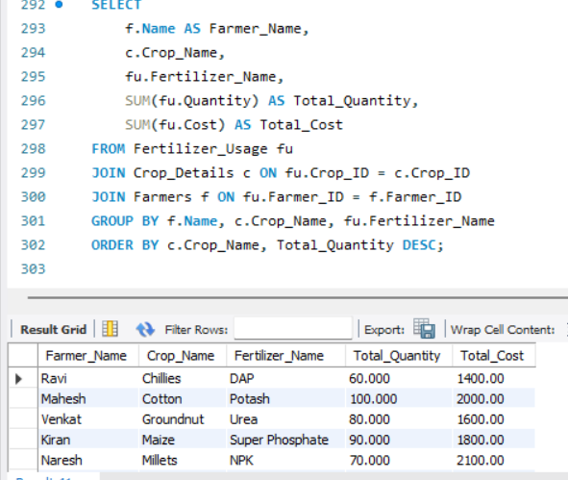
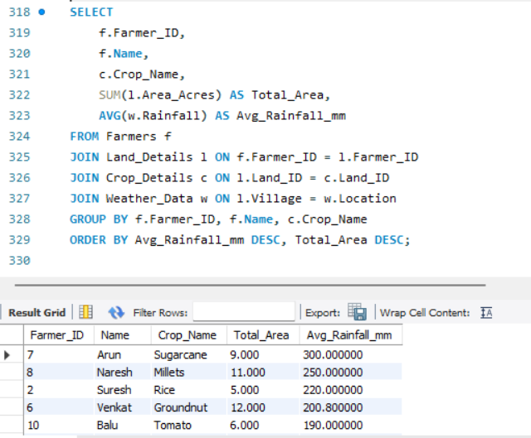
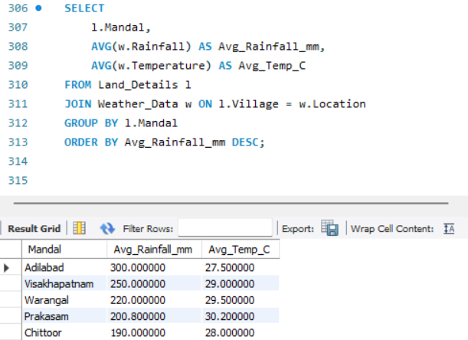
Q7.Fertilizer usage per crop
Q9.Farmer-wise crop areas vs rainfall
Weather Analysis
Q8. Track average rainfall per Mandal

Slide 12
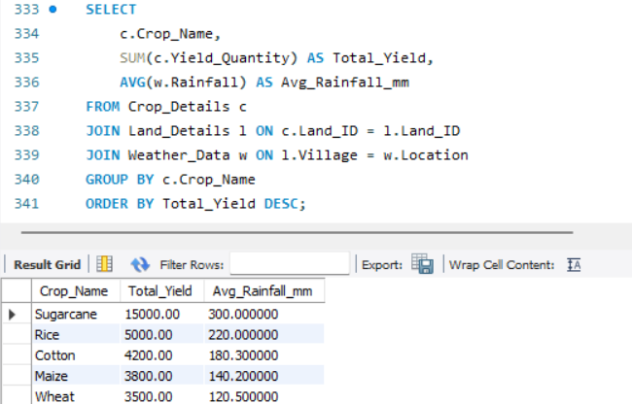
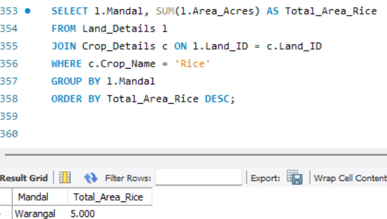
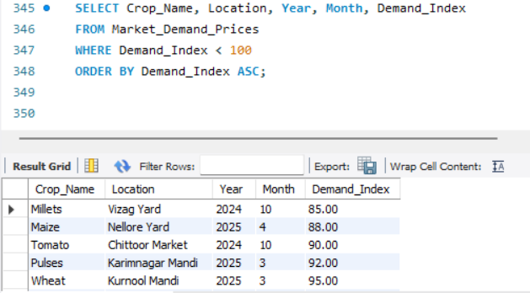
Q10. Crop yield vs rainfall trend
Q12.Total land area per Mandal growing Rice
Market Insights & Crop Planning
Q11.Low-demand crops in a market

Slide 13
Insights & Analysis
Identifies the farmer with land holding what type of crop they are sowing in each season
Track the usage of fertilizer for each crop
Track the expenses of the farmer during the crop season
Relation between rainfall and yield of the crop
Analyze the market demand

Slide 14
Impact of AgriTrack
📜 Proper Land Records → Reduce disputes, enable accurate subsidies & loans.
🧪 Optimized Fertilizer Usage → Suggests correct quantity, prevents wastage & shortage.
🌱 Crop Planning by Demand → Guides farmers to sow profitable crops, avoids oversupply/shortage.
💰 Financial Tracking → Records income & expenditure, helps farmers know profit/loss.
☔ Weather-Based Insights → Links rainfall & yield, supports risk management.
🏛️ Government Decision Support → Better planning of fertilizer distribution & market stability.

Slide 15
Conclusion:
AgriTrack ensures better land records, crop planning, and fertilizer use while linking weather and market demand.
It empowers farmers with data-driven decisions and helps the government create strong agricultural policies.

Slide 16


